Slide 1
Chapter 27

Slide 2
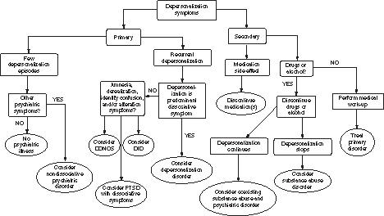
Figure 1 Differential diagnosis decision tree of depersonalization.
Adapted with permission from Ref. 16.

